Slide 1

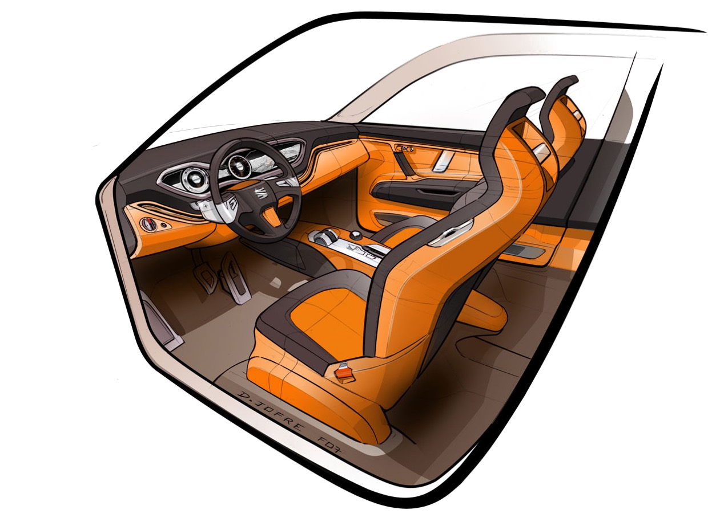
CSS
(Cascading Style Sheets)
Style: Sets the look and feel.
Colors & Fonts: Customizes text and background.
Layout: Controls position and size.
Selectors: Targets specific HTML elements.

Slide 2





Importance of CSS
Premium Website
Premium Brand
Premium Customer
High Salary Developer

Slide 3
Level 1
CSS Basics
Basic Syntax
Color Property
Including Styles
HTML Refresher
Comments
MDN Documentation
Browser Tools
Selectors

Slide 4
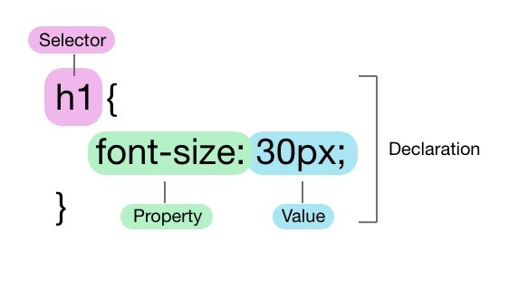
1. Basic Syntax
Selector: The HTML element that you want to style.
Property: The attribute you want to change (like font, color,
etc.).
Value: The specific style you want to apply to the property (like red, bold, etc.).

Slide 5
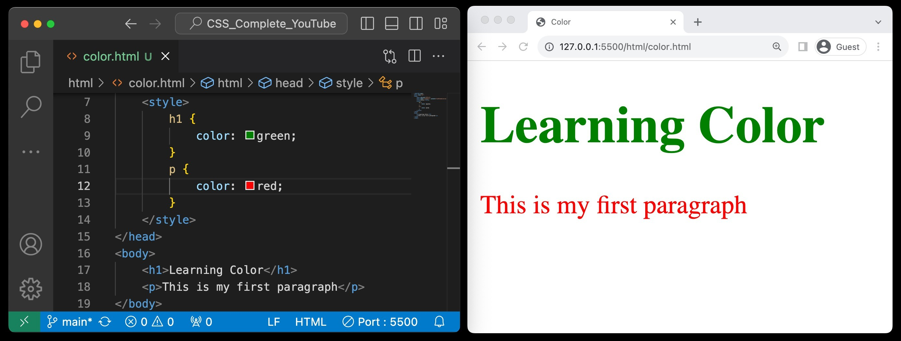
2. Color Property
Definition: The CSS color property defines the text color or foreground color in an HTML element.
Enhancement: Use it to emphasize sections and elevate webpage aesthetics.

Slide 6
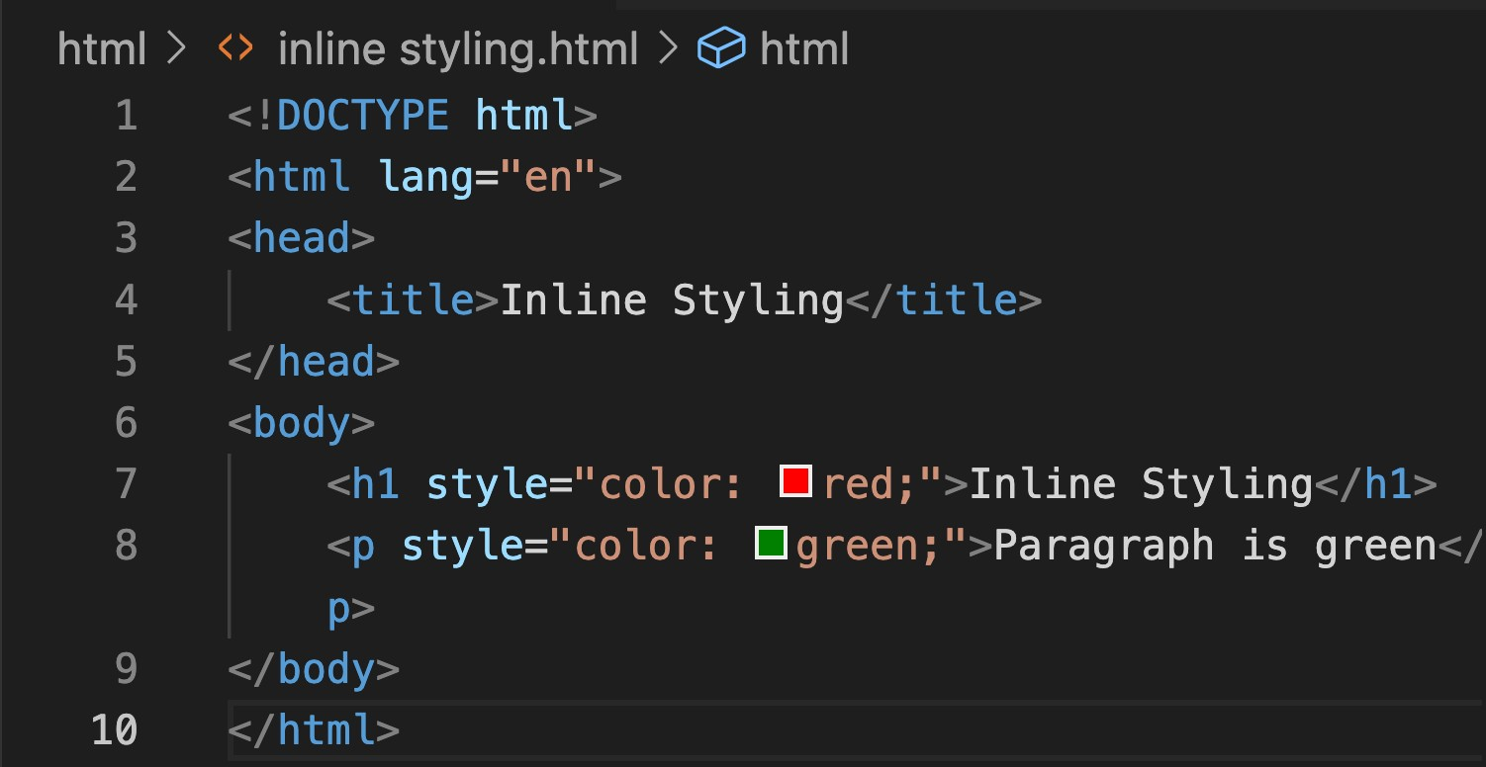
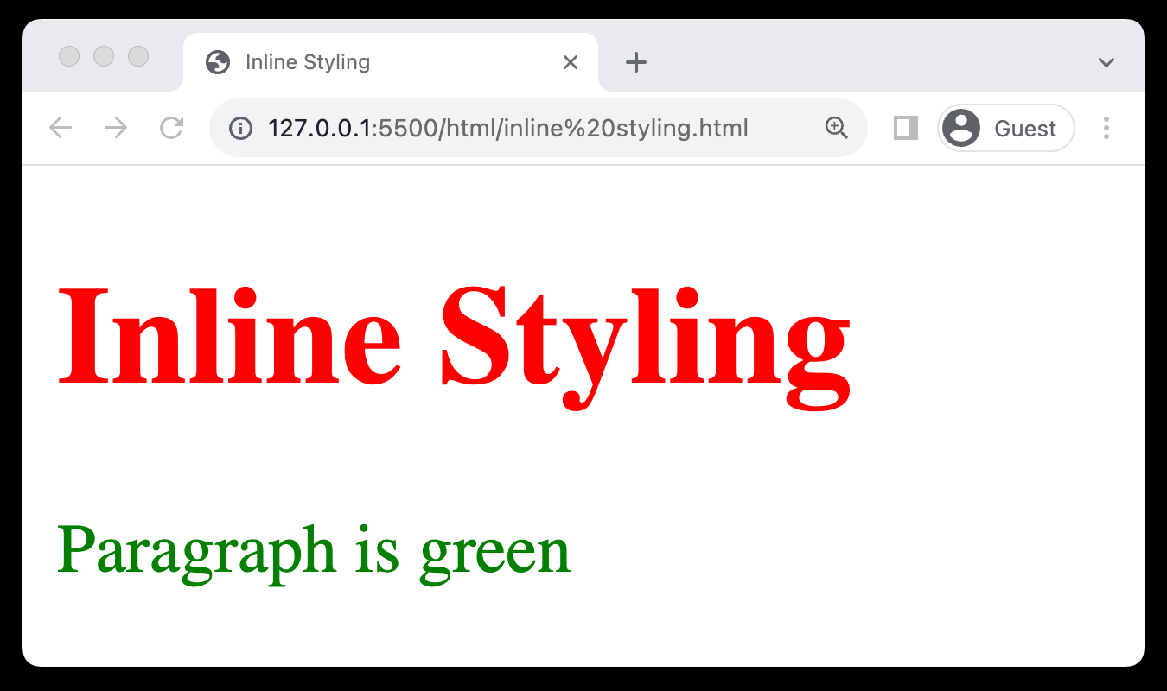
3. Including Styles (Inline Styling)
Direct Application: Apply styles directly to HTML elements using the style attribute.
One-off Changes: Ideal for single, unique style alterations.
Can Be Cluttered: May lead to cluttered HTML if used extensively.
Limited Reusability: Reduces the reusability of CSS rules in larger projects.

Slide 7
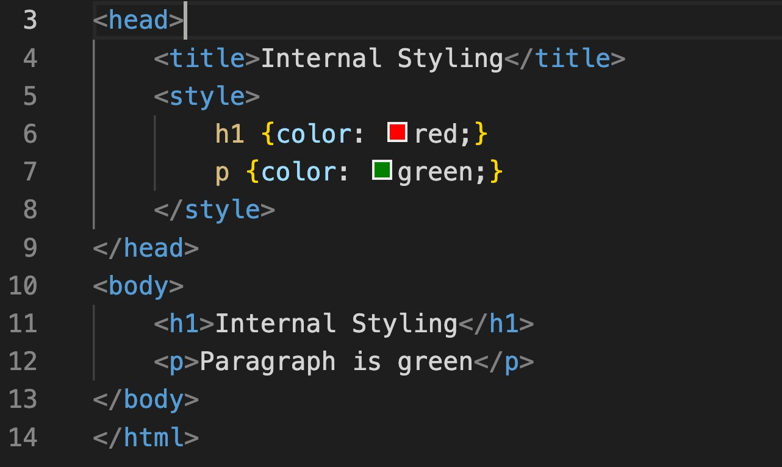
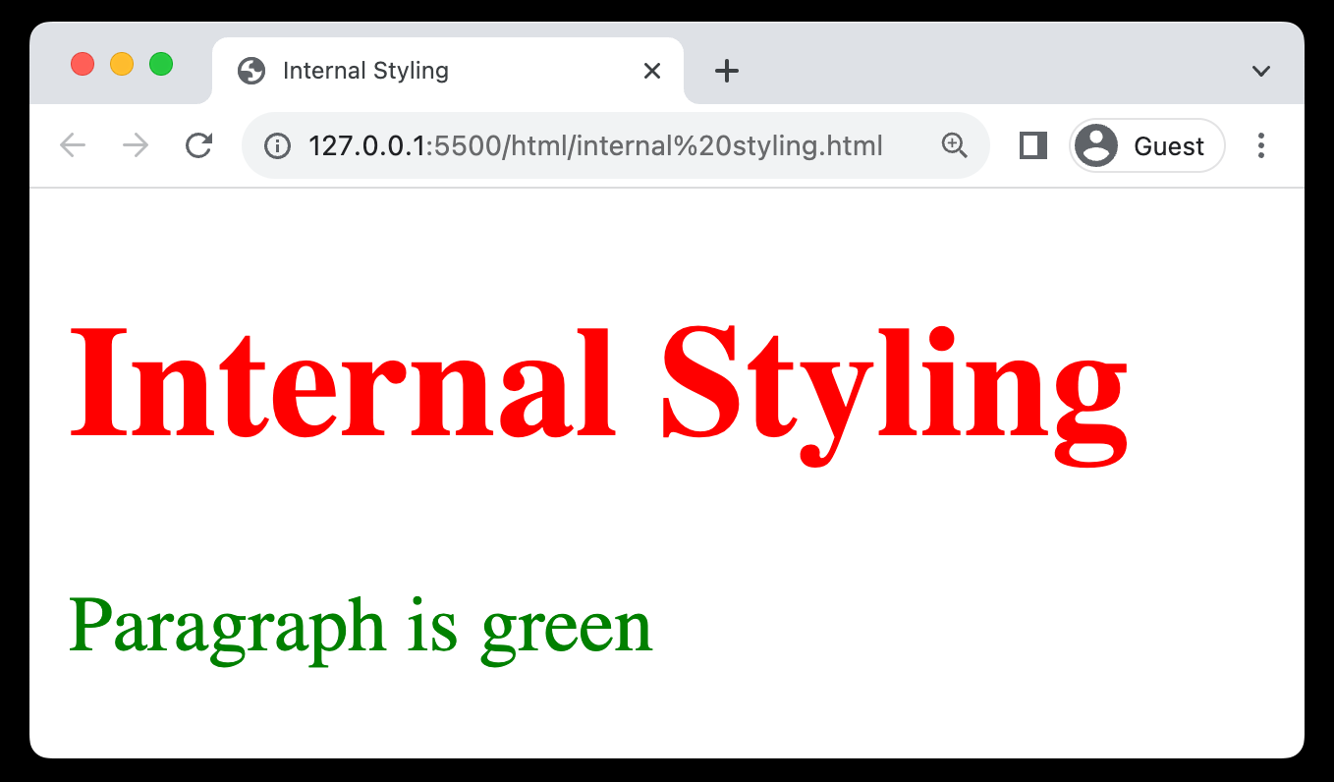
3. Including Styles (Internal Styling)
Embedded CSS: Styles are placed within <style> tags in the HTML head section.
Cleaner than Inline: More organized compared to inline styles.
Reusable Styles: Allows for some reuse of styles across the page.

Slide 8
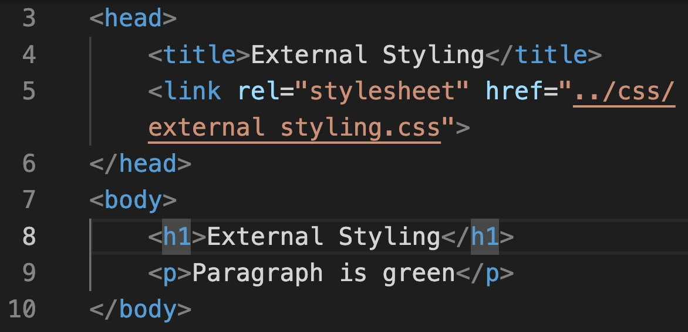
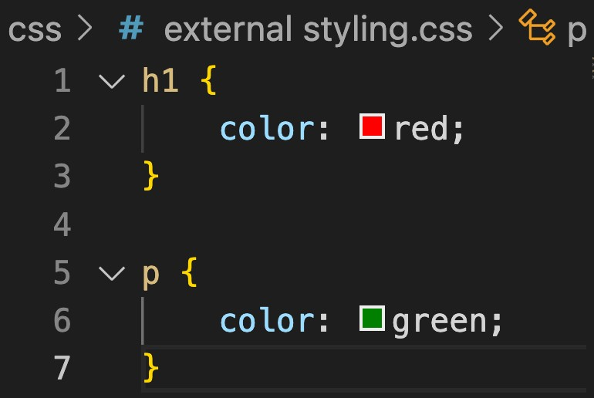
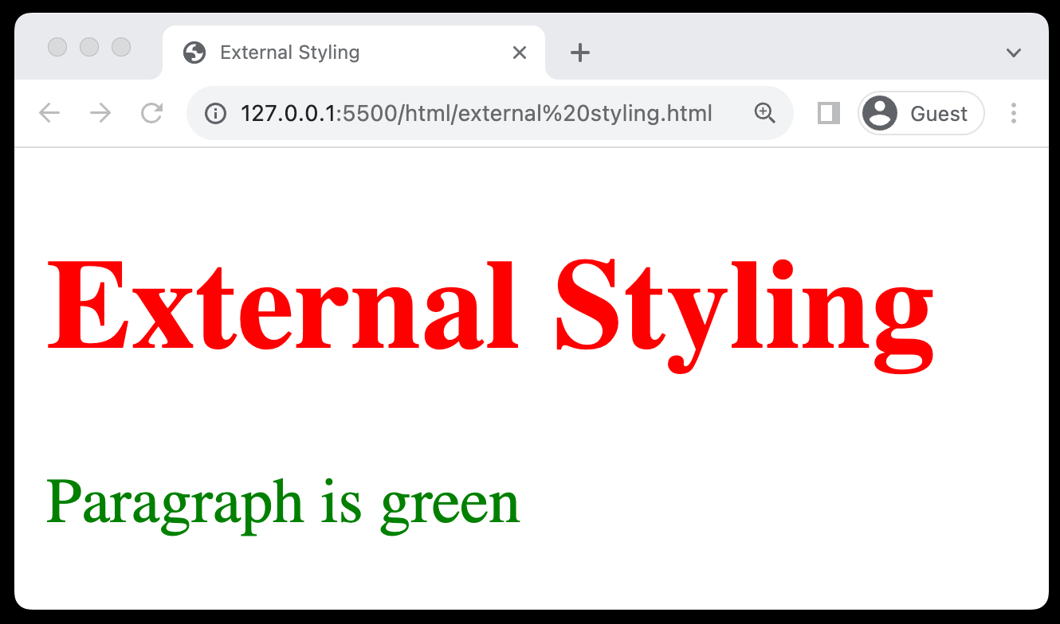
3. Including Styles (External Styling)
Separate CSS File: Stores styles in a separate .css file, linked to HTML.
Reusable: Enables style reuse across multiple webpages.
Link in HTML: Use the <link> tag within the <head> section to link the CSS.
Relative or Absolute Path: The href attribute can contain a relative or absolute path to the CSS file.

Slide 9
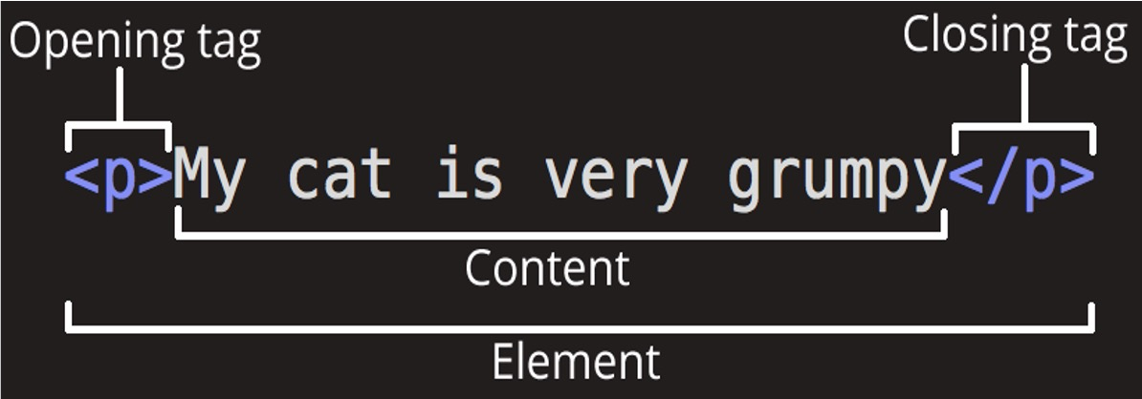
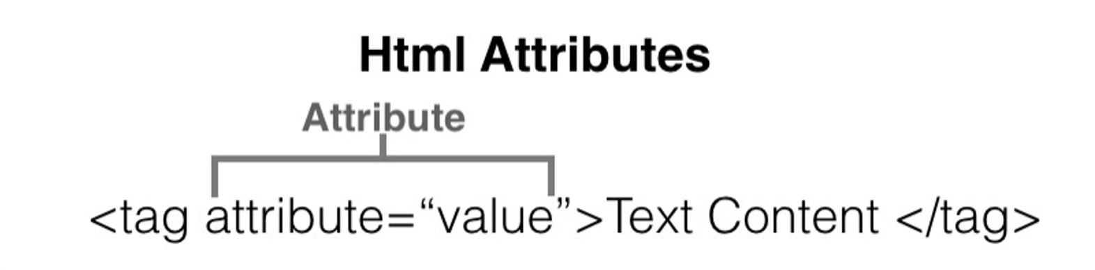
4. HTML Refresher (Tags & Attributes)
Elements that are used to create a website are called HTML Tags.
Tags can contain content or other HTML tags.
Define elements like text,
images, links
Provides additional information about elements
Use name=value format

Slide 10
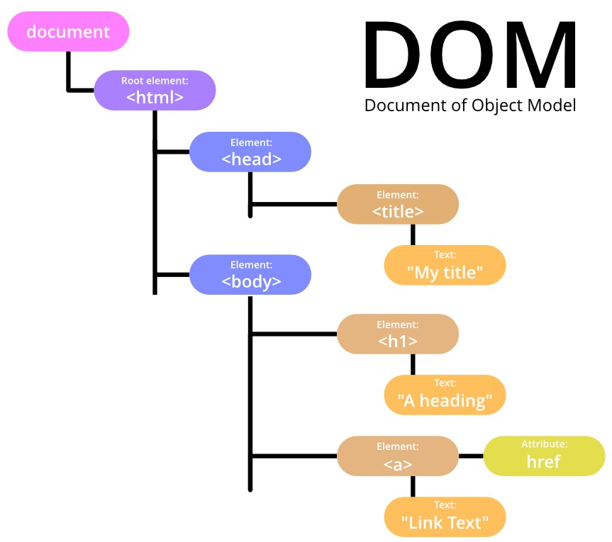
4. HTML Refresher (DOM)
Structure Understanding: Helps in understanding the hierarchical structure of a webpage, crucial for applying targeted CSS styles.
Dynamic Styling: Enables learning about dynamic styling, allowing for real-time changes and interactivity through CSS.

Slide 11
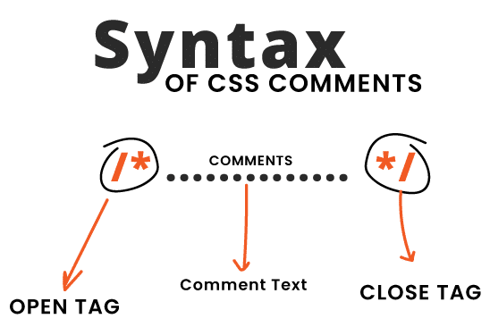
5 Comments
Used to add notes in HTML or CSS code
Not displayed on the web page
Syntax: <!-- Comment here -->
Helpful for code organization
Can be multi-line or single-line

Slide 12
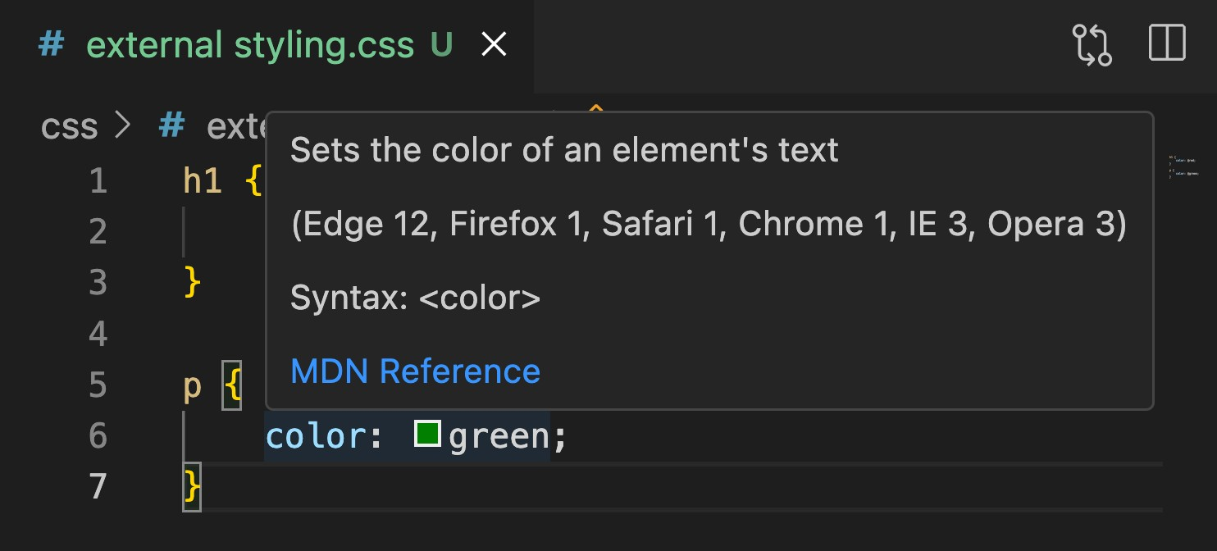
6.MDN Documentation
For Official resource for CSS, visit https://developer.mozilla.org/
Includes examples for real-world use
Updated with latest CSS-3 features
Trusted by developers worldwide

Slide 13
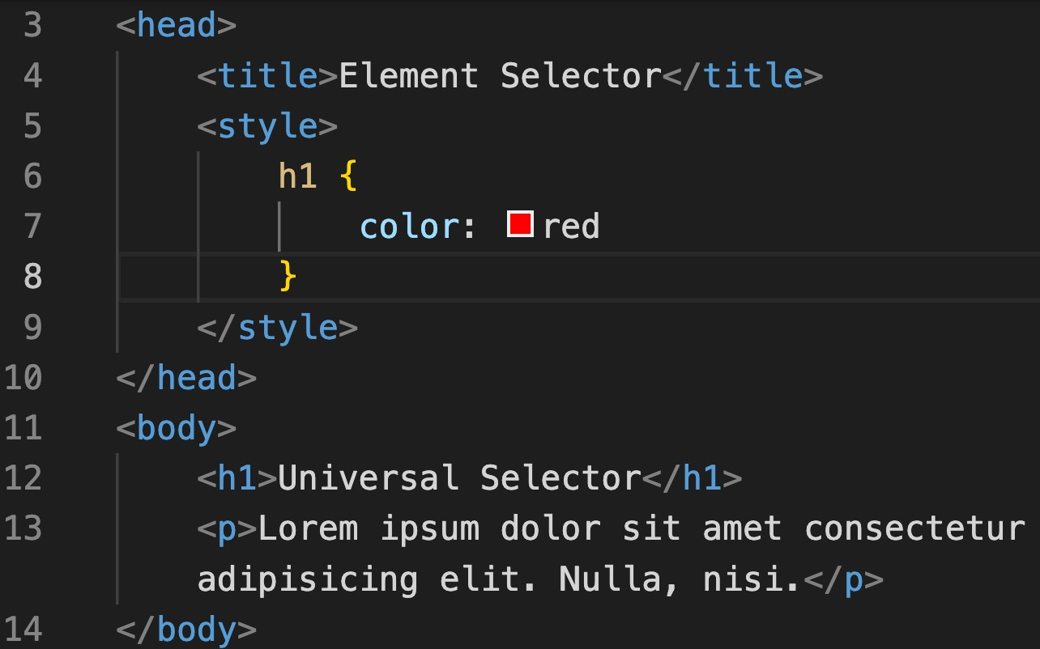
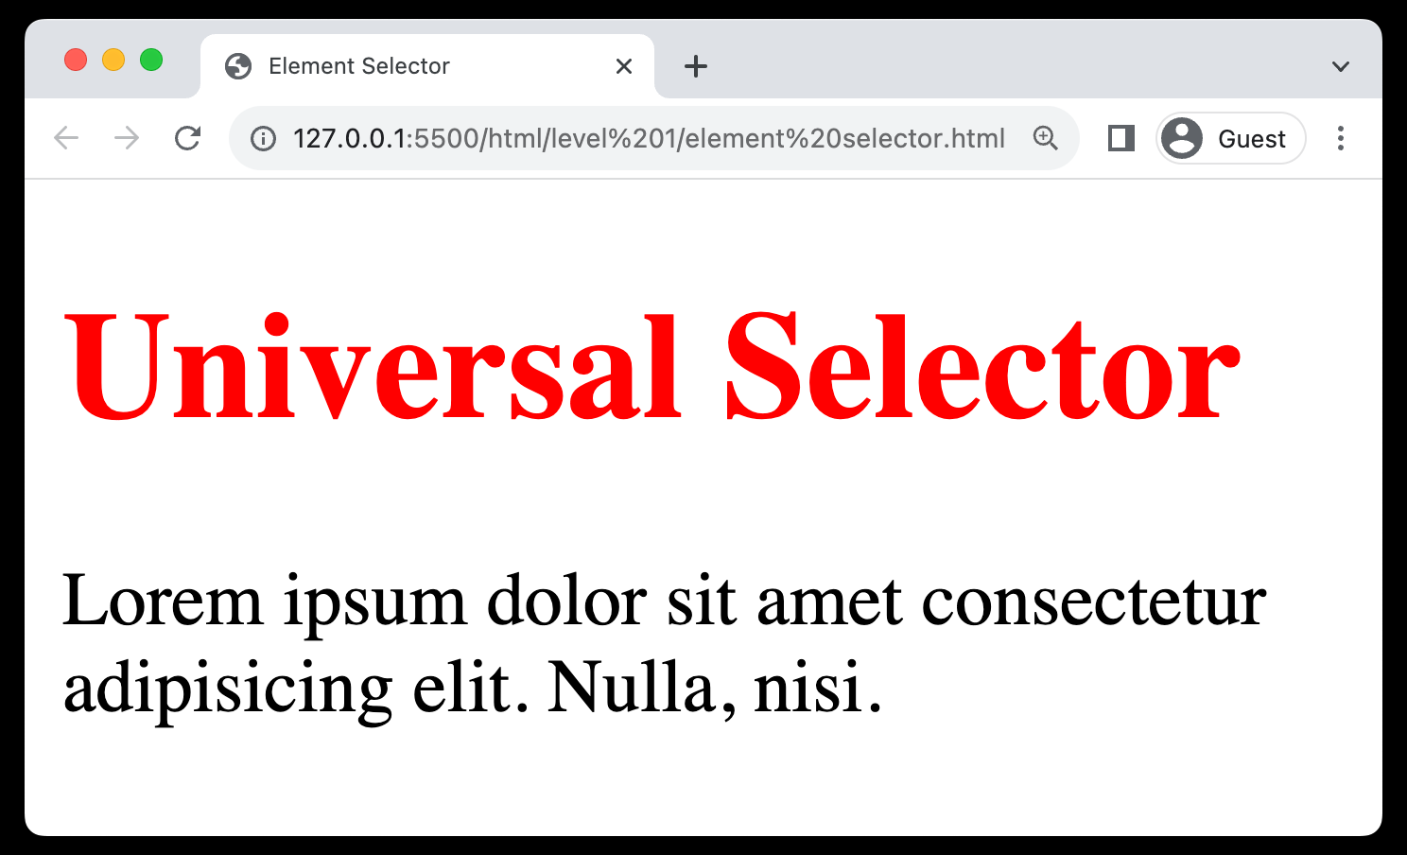
8. Selectors (Element selector)
Targets Elements: Selects HTML elements based on their tag name.
Syntax: Simply use the element's name
Uniform Styling: Helps in applying consistent styles to all instances.
Ease of Use: Straightforward and easy to implement for basic styling.

Slide 14
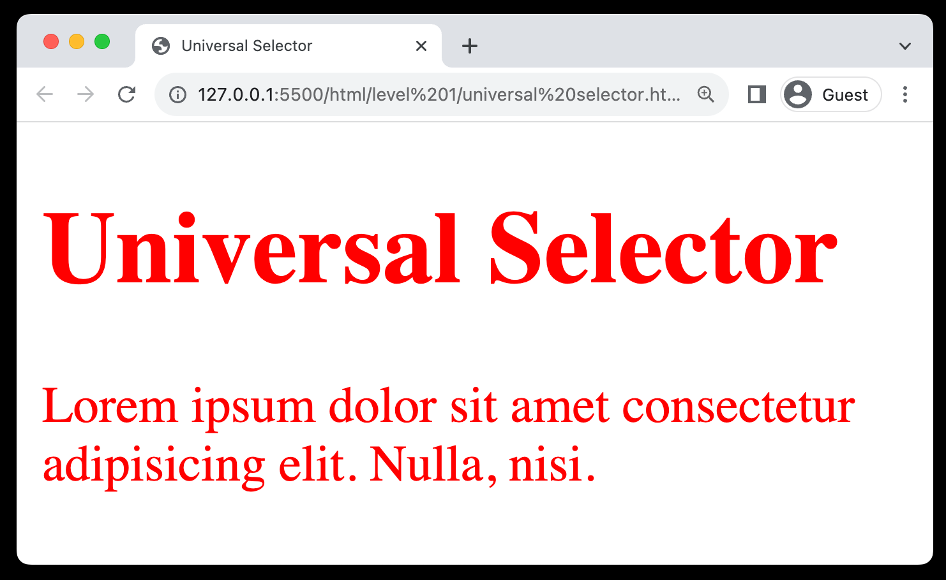
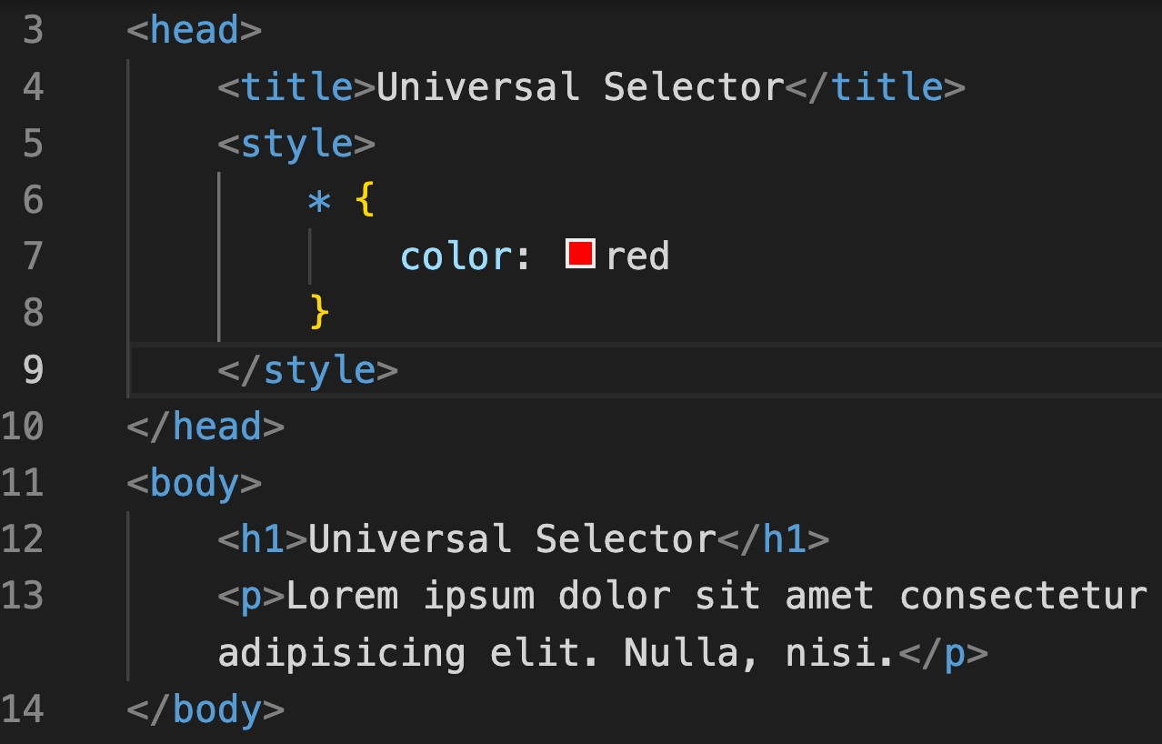
8. Selectors (Universal selector)
Matches All: Targets and styles all elements on a webpage.
Syntax: Utilized as an asterisk (*).
Resets Styles: Commonly used to reset margins and paddings globally.
Broad Styling: Useful for setting universal attributes like font or color.
Usage Caution: Can cause style conflicts due to its wide-reaching effects.

Slide 15
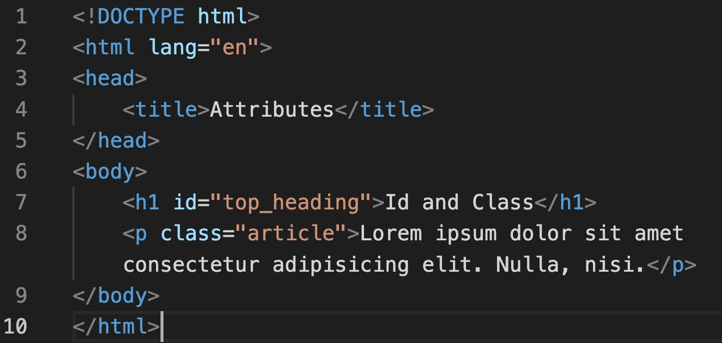
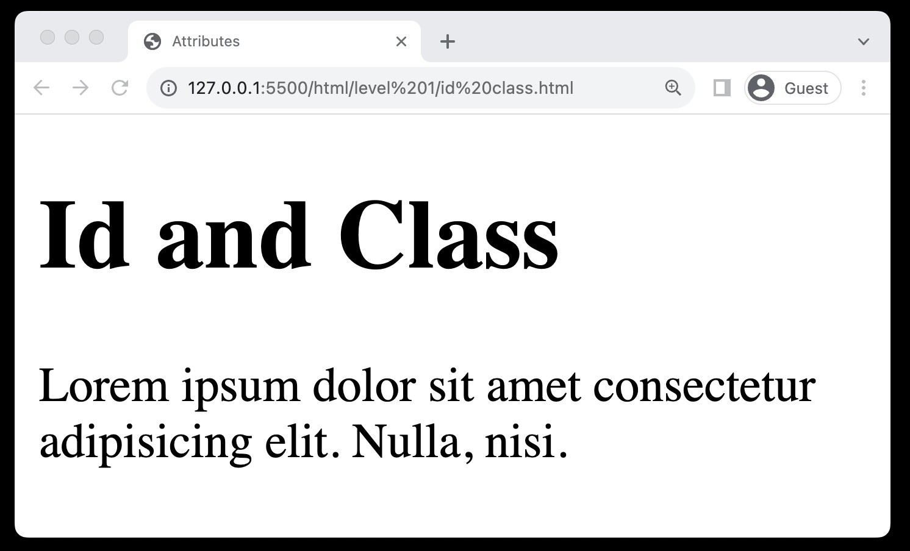
8. Selectors (id & class property)
ID Property: Assigns a unique identifier to a single HTML element.
Class Property: Allows grouping of multiple HTML elements to style them collectively.
Reusable Classes: Class properties can be reused across different elements for consistent styling.
Specificity and Targeting: Both properties assist in targeting
specific elements or groups of elements for precise styling.

Slide 16
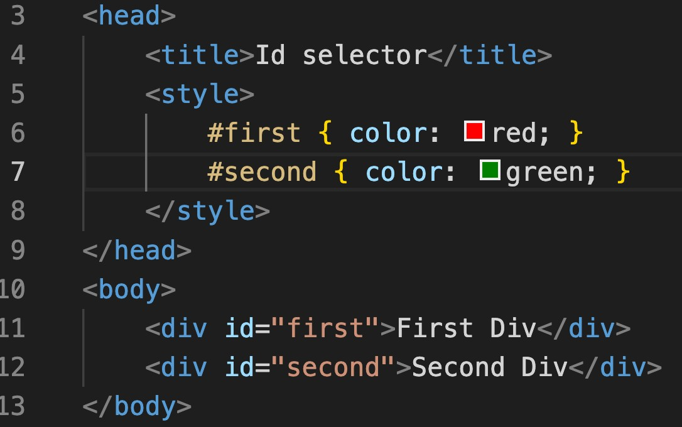
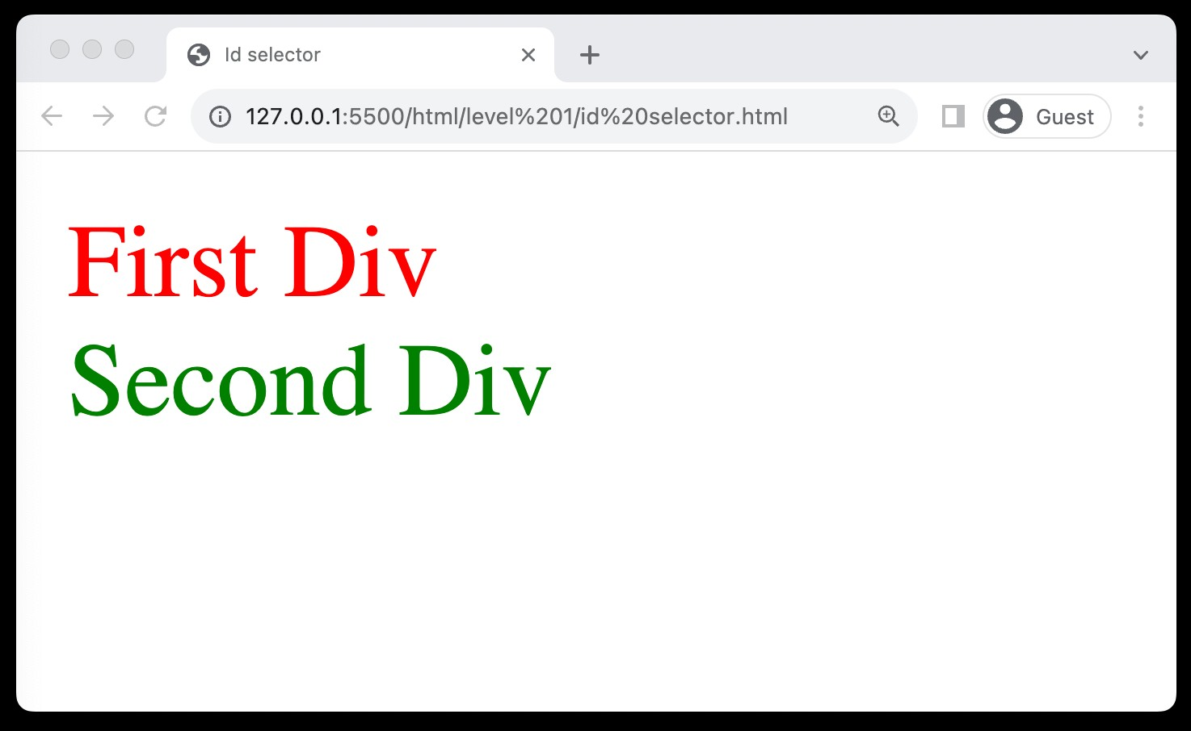
8. Selectors (Id selector)
Unique Identifier: Targets a specific element with a unique ID attribute.
Syntax: Uses the hash (#) symbol
Single Use: Each ID should be used once per page for uniqueness.
Specific Targeting: Ideal for styling individual, distinct elements.

Slide 17
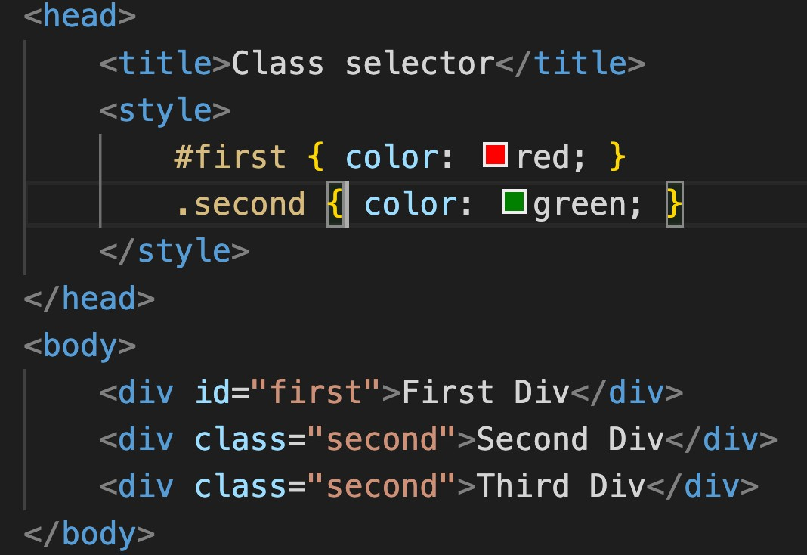
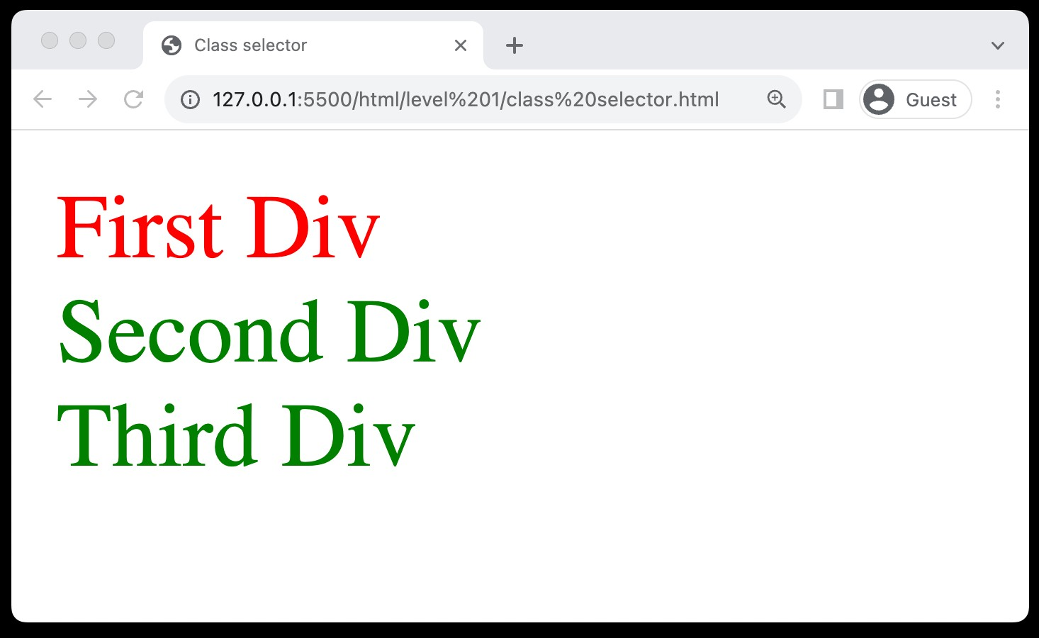
8. Selectors (Class selector)
Group Styling: Allows styling of multiple elements grouped under a class.
Syntax: Utilizes the dot (.) symbol.
Reusable: Can be used on multiple elements for consistent styling.
Versatility: Ideal for applying styles to a category of elements.

Slide 18
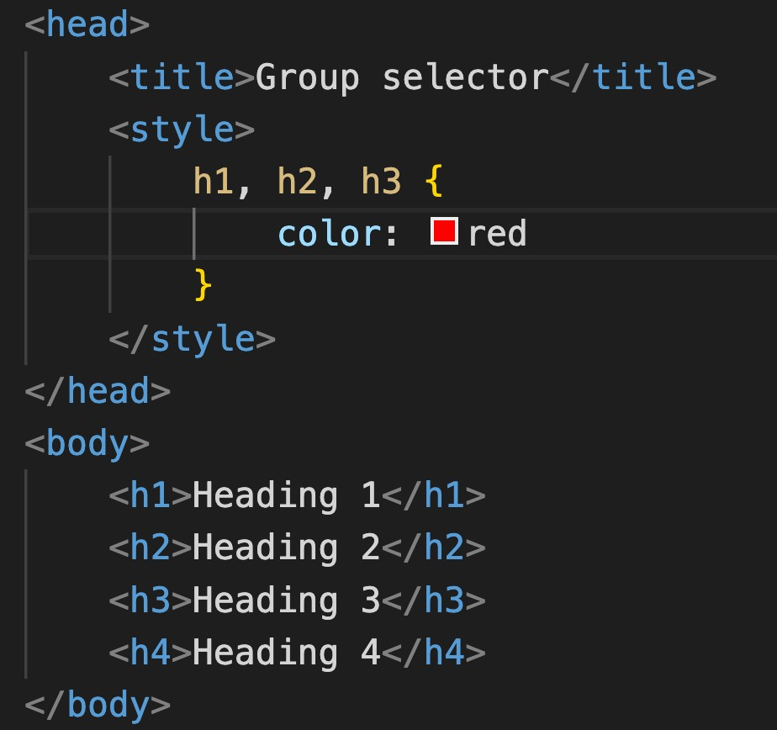
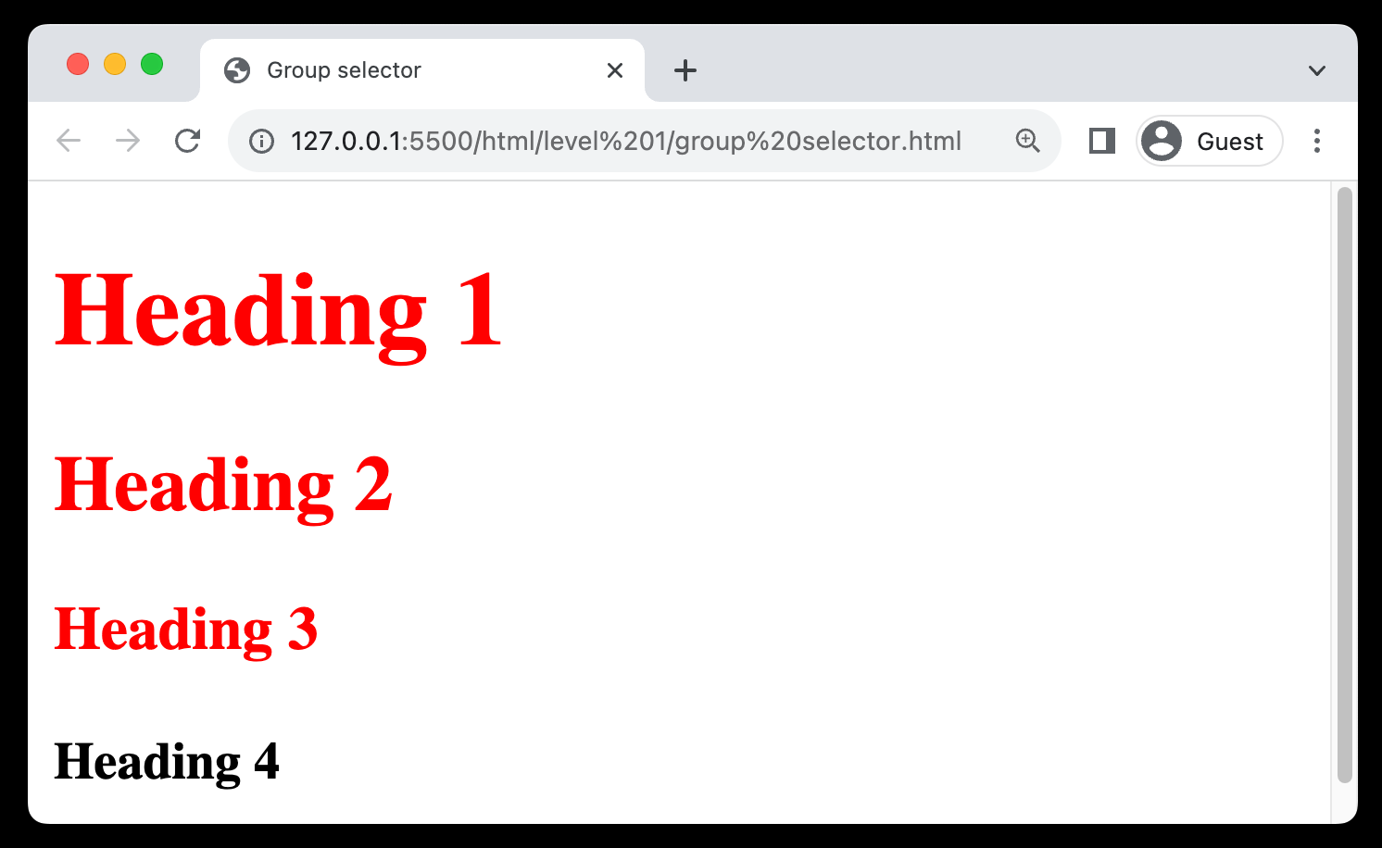
8. Selectors (Group selector)
Multiple Elements: Styles multiple elements simultaneously.
Syntax: Separates selectors with commas.
Efficiency: Reduces code redundancy and saves time.

Slide 19
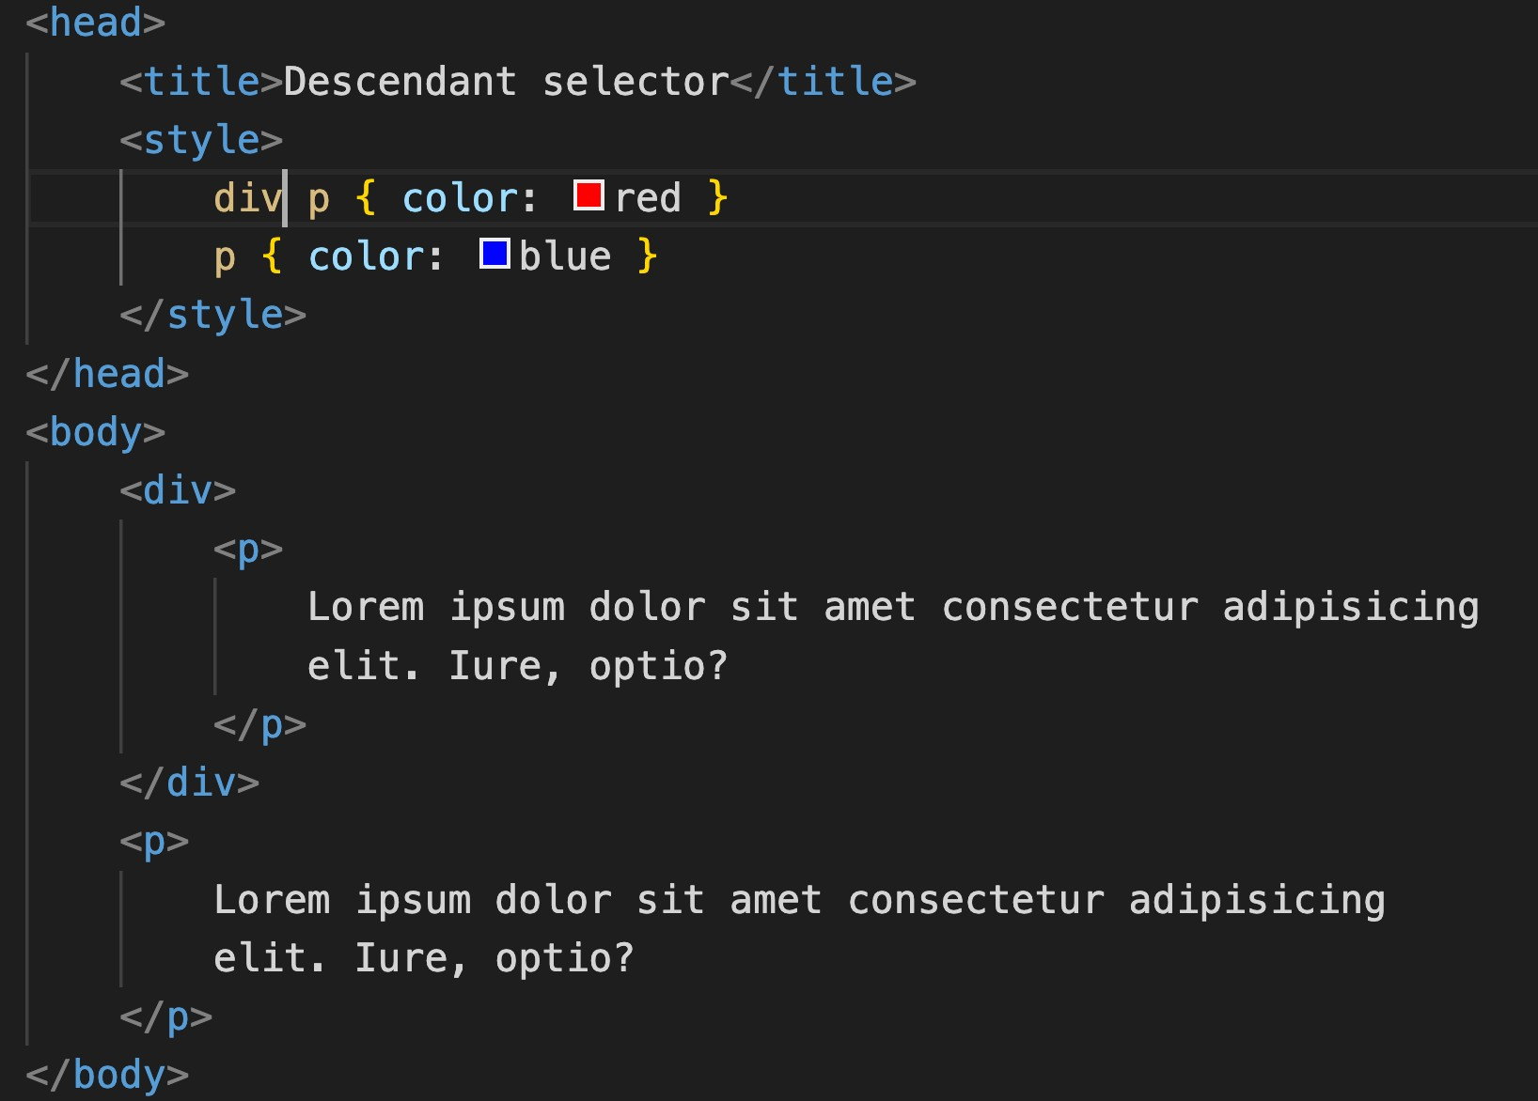
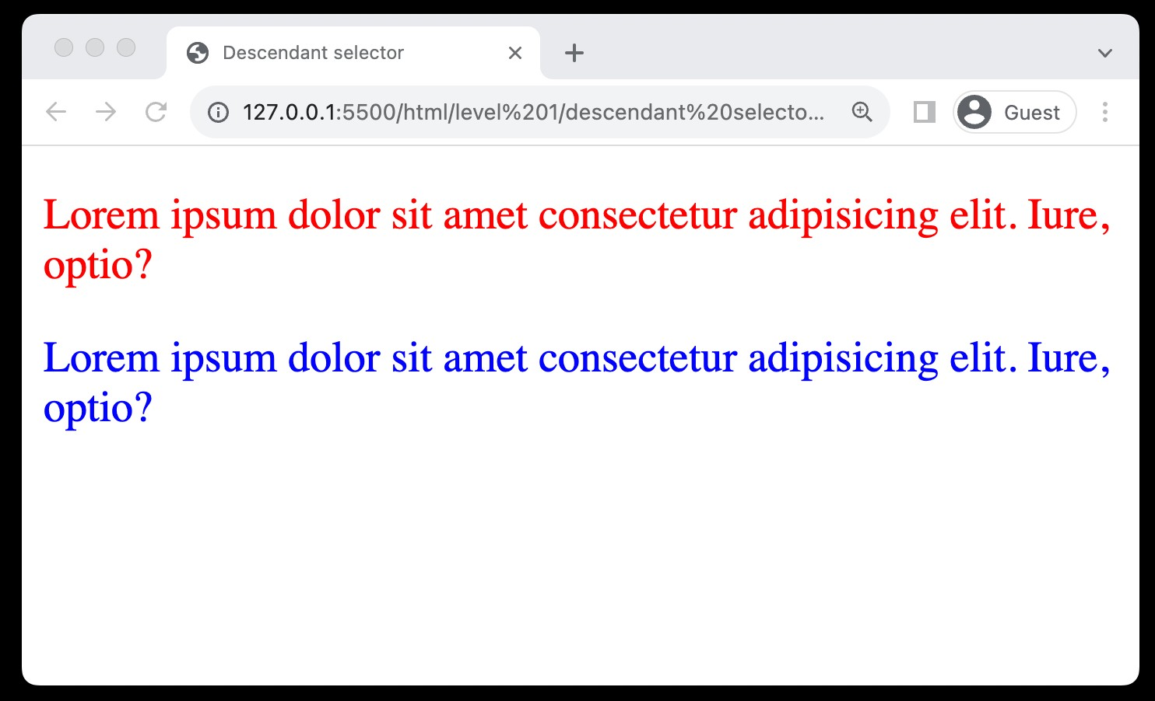
8. Selectors (Descendant selector)
Nested Targeting: Styles elements nested within a specified element.
Syntax: Separate selectors with spaces.
Hierarchy-Based: Allows styling based on the hierarchical structure of HTML.
Specific Styling: Facilitates more targeted and specific styling of elements.

Slide 20

Practice Set Level 1
CSS Basics
Create a heading and set the text color red.
Create a div with id #heading, include CSS using all 3 ways line, style tag and external, and observe priority.
Add comments to your CSS class
Create a div, paragraph and heading and use id Selector, element selector and class selector for them.
Create two divs with id first and second and define color for both using group selector.

Slide 21
Level 2
Color System & Background
Background-Color Property
Color System
Absolute Units
Height & Width Property
Background-Image Property
Visibility Property

Slide 22
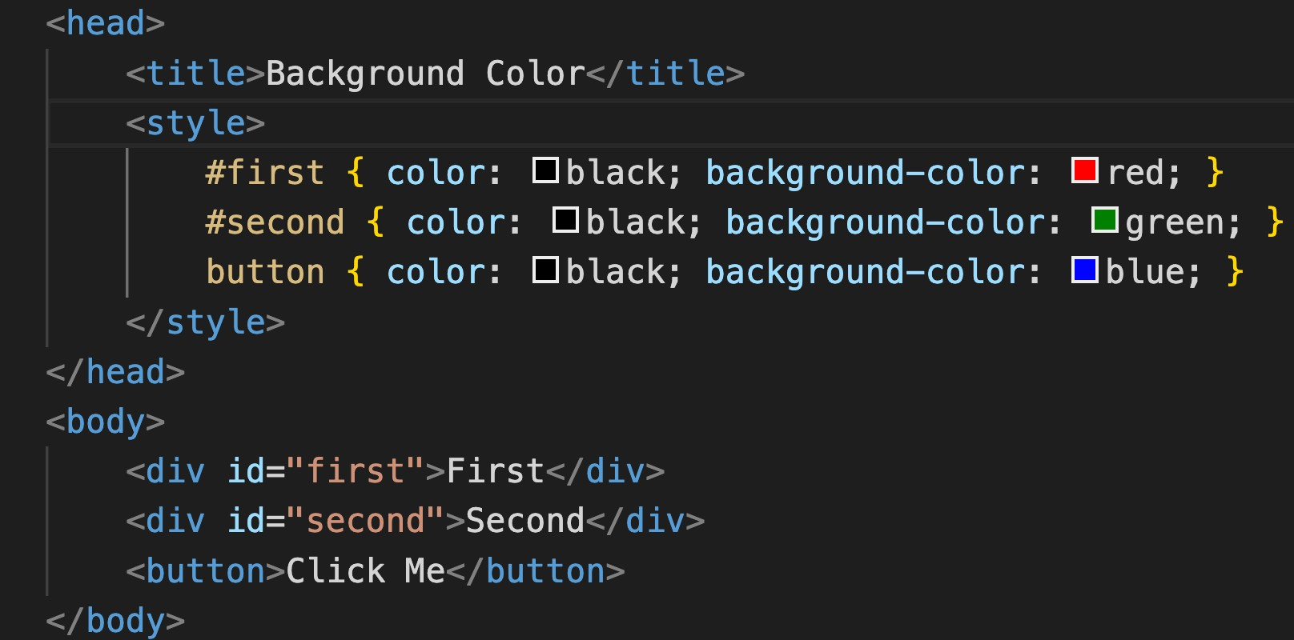
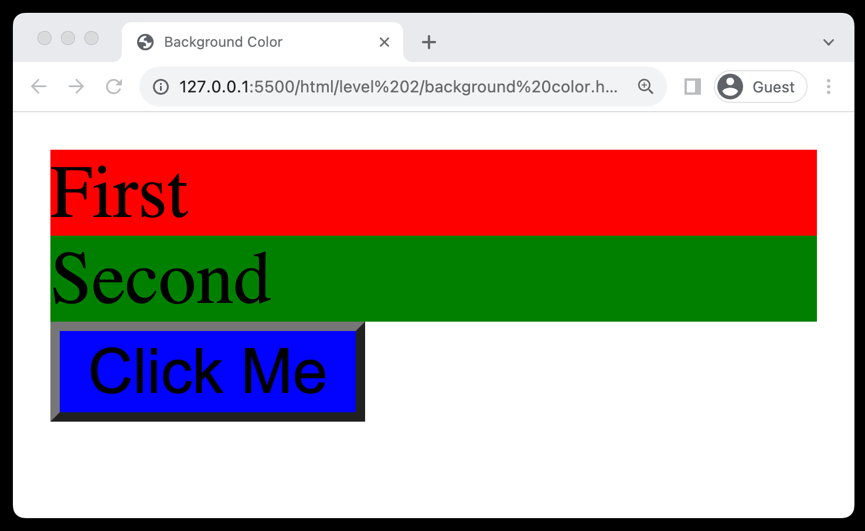
9. Background Color
Definition: Sets the background color of an element.
Syntax: Utilized as background-color: color;
Visual Appeal: Enhances the visual appeal and contrast of webpage elements.

Slide 23
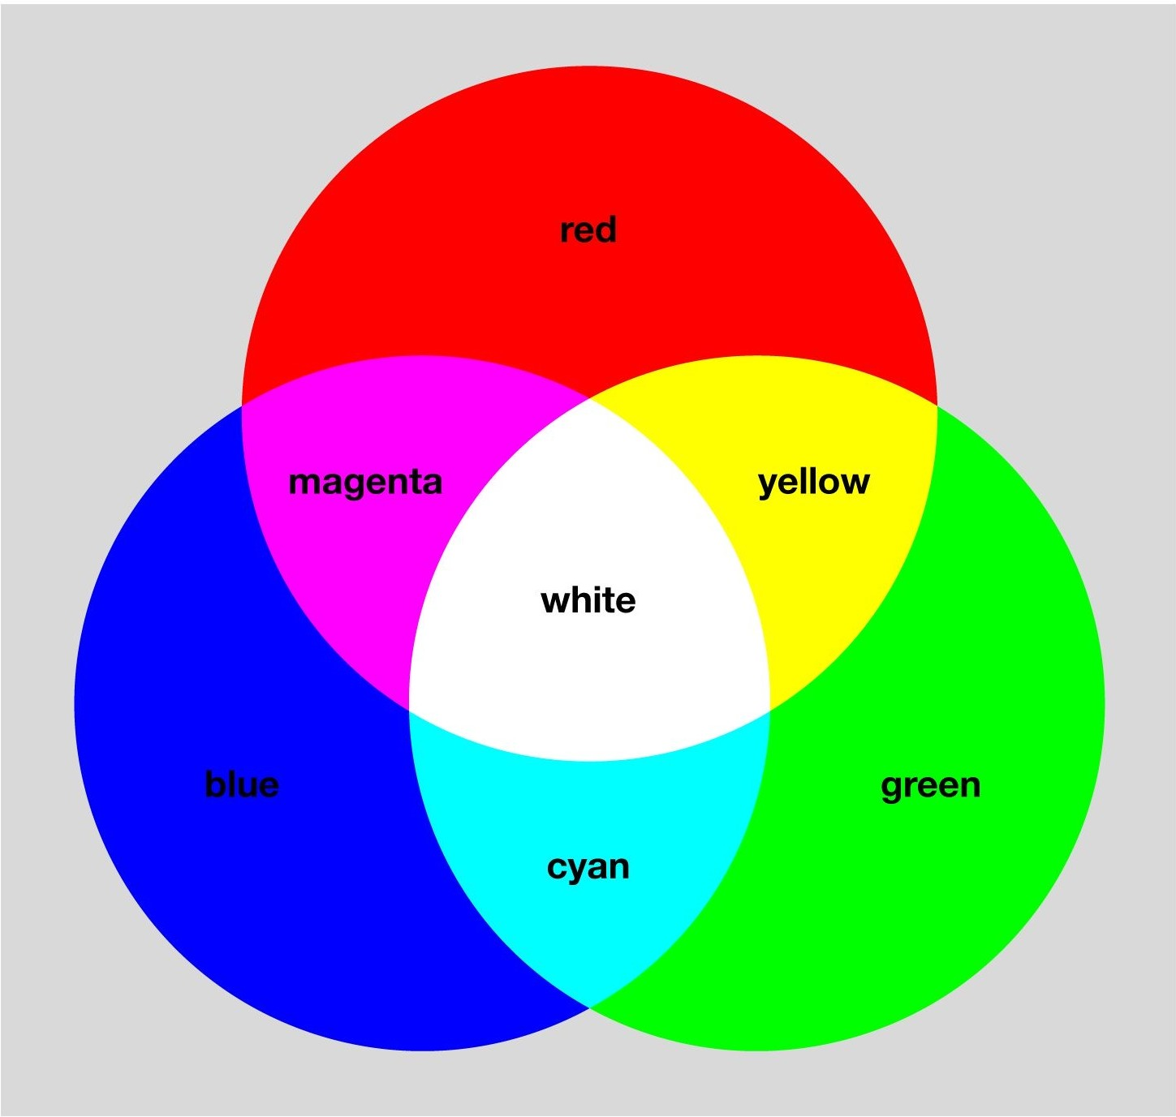
10. Color System (Color Theory)
RGB Model: Creates colors by mixing Red (R), Green (G), and Blue (B) light sources.
Additive Model: More light means increased brightness.
Primary Colors: R, G, and B are the foundational colors.
White & Black: All combined yield white; absence equals black.
Color Depth: Allows for millions of color variations.

Slide 24
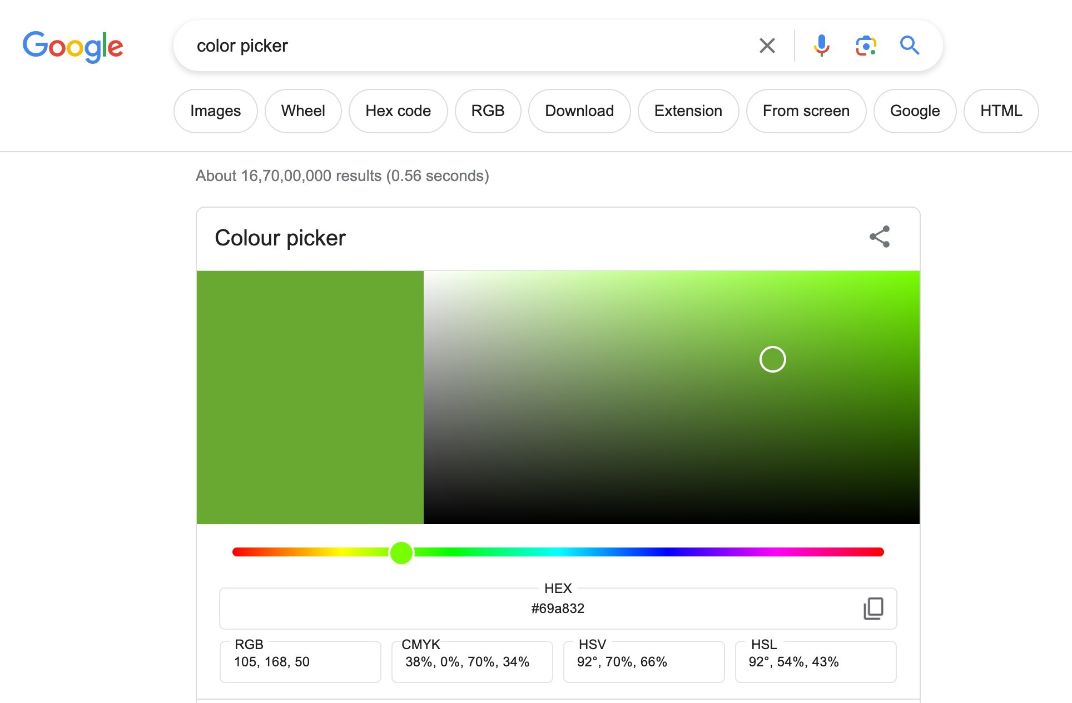
10. Color System (color picker)

Slide 25
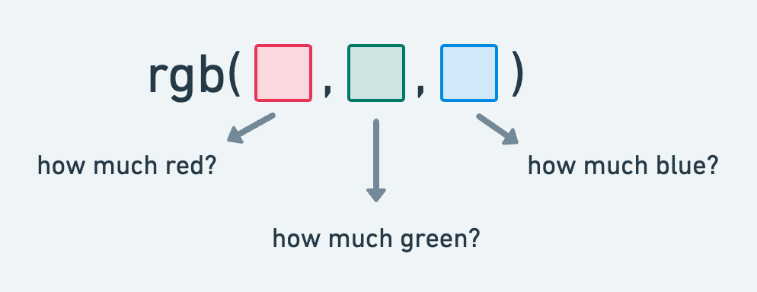
10. Color System (RGB Color Model)
Three Channels: Consists of Red (R), Green (G), and Blue (B) channels to create a variety of colors.
Syntax: Utilized as rgb(r, g, b) where r, g, and b are values between 0 and 255.

Slide 26
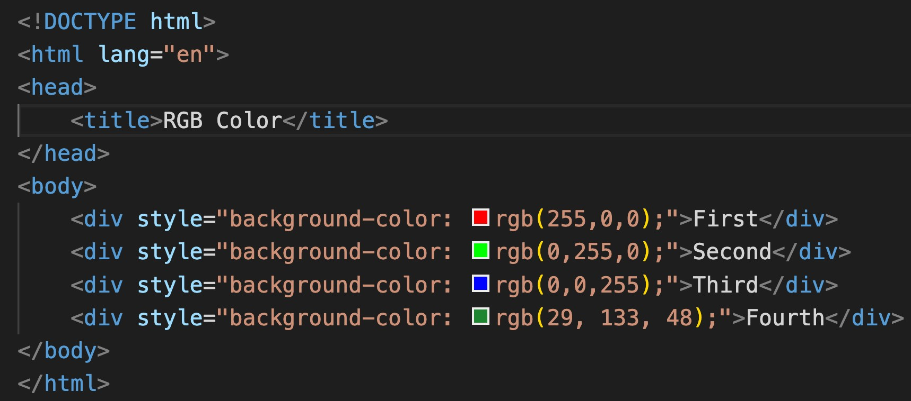
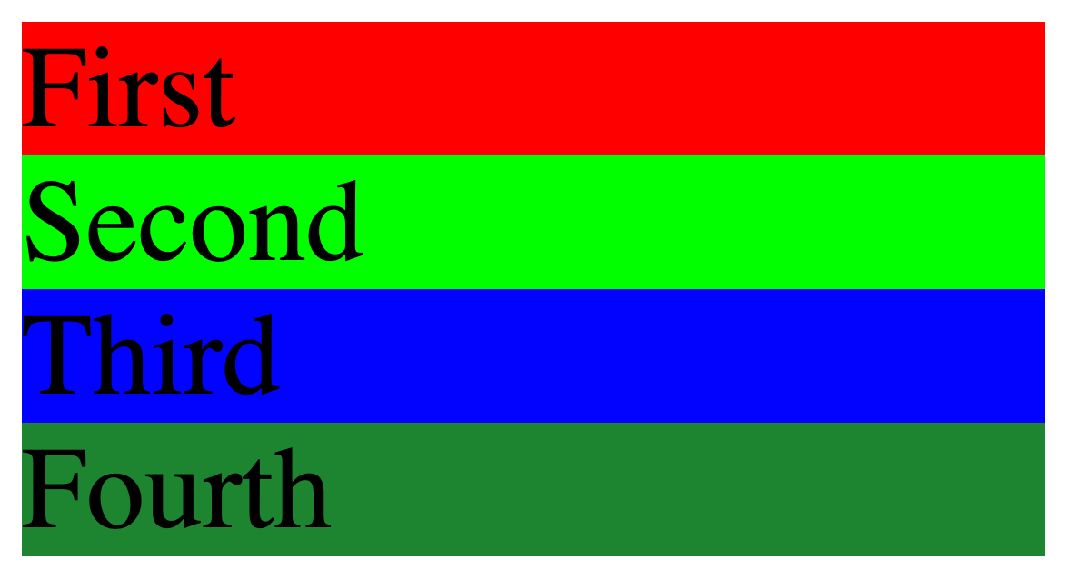
10. Color System (RGB Color Model)

Slide 27
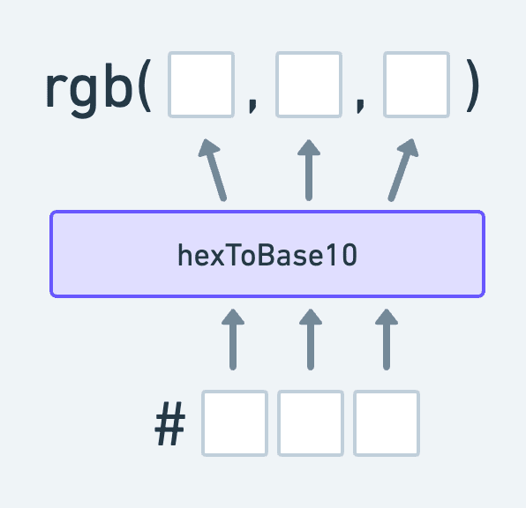
10. Color System (HEX Color Model)
Hexadecimal Codes: Represents colors using hexadecimal values, consisting of 6 digits combined from numbers and letters (A-F).
Syntax: Written as #RRGGBB
Easy Color Matching: Facilitates easy color matching with graphic design tools and branding colors.
Web Standards: Widely supported and a common standard for defining colors in web design

Slide 28
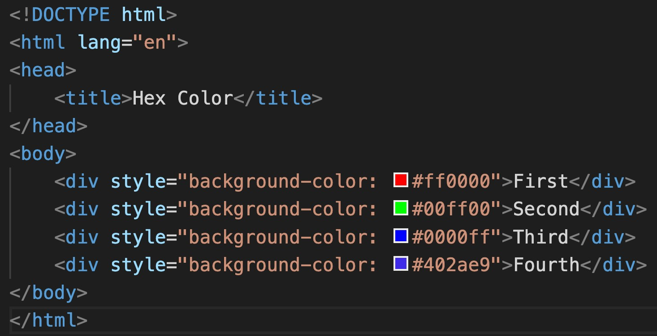
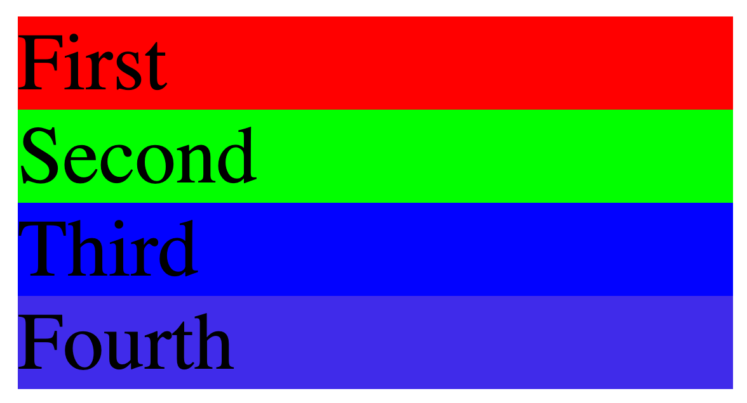
10. Color System (HEX Color Model)

Slide 29
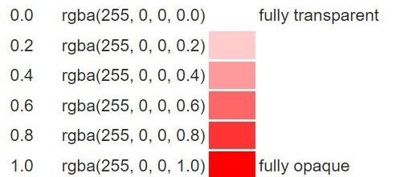
10. Color System (Alpha Channel)
RGBA: RGB's extension, includes alpha for opacity control (0-1 range).
Transparency Control: Facilitates the adjustment of transparency levels in colors.
Visual Effects: Enables the creation of visual effects like shadows and overlays.
Layering: Assists in layering elements with varying degrees of visibility.

Slide 30
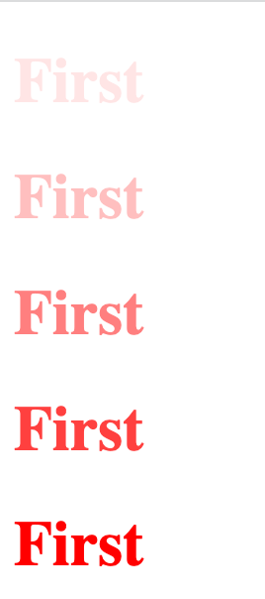
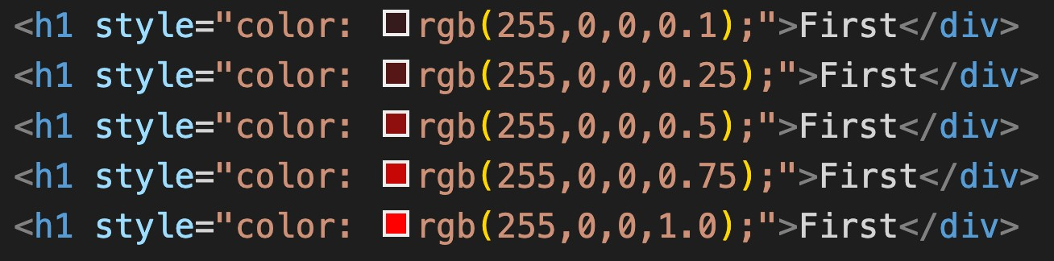
10. Color System (Alpha Channel)

Slide 31
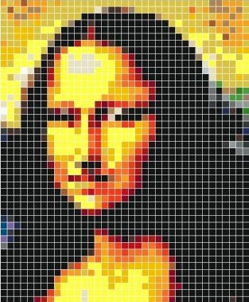
11. Absolute Units
Definition: Pixels (px) are fixed-size units, representing a dot on a computer screen.
Precision: Allows for precise control over element dimensions.
Graphics & Web Design: Commonly used in graphics and web design for setting font sizes, margins, and more.
Cross-Browser Consistency: Provides consistency across different browsers.
High-DPI Displays: Can vary in appearance on high-DPI (dots per inch) displays.

Slide 32
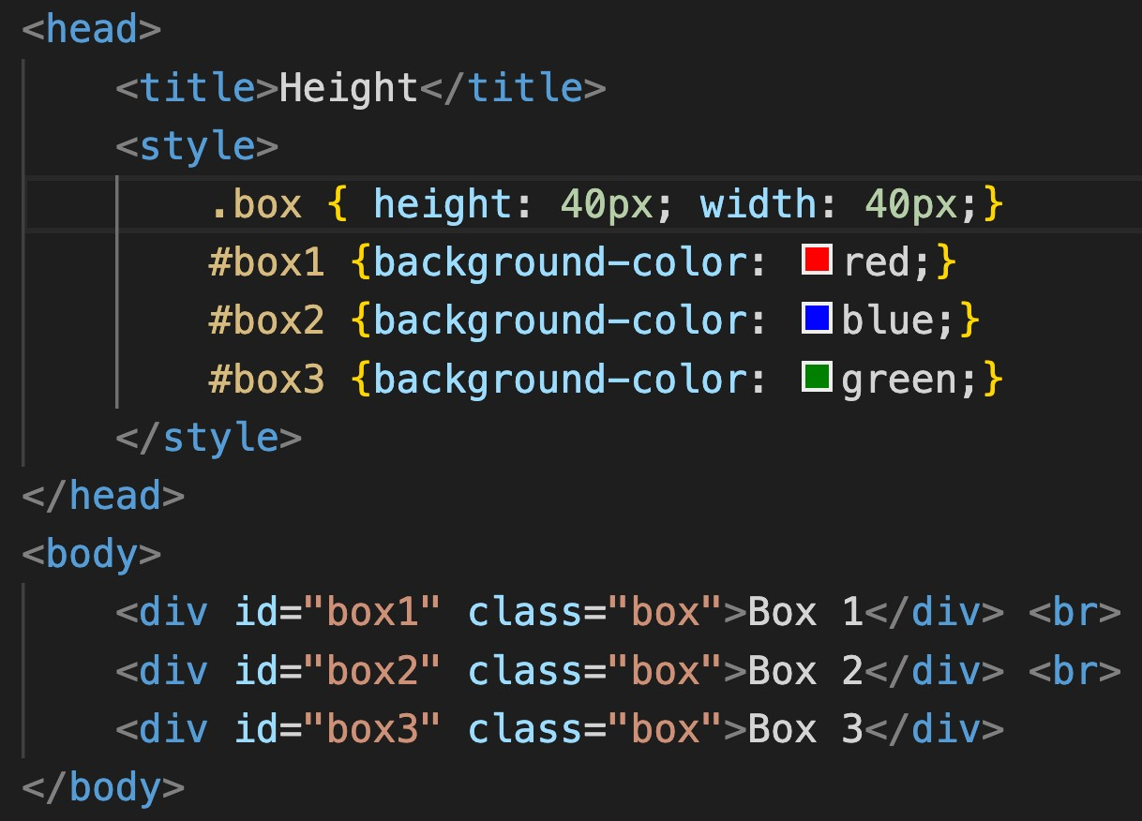
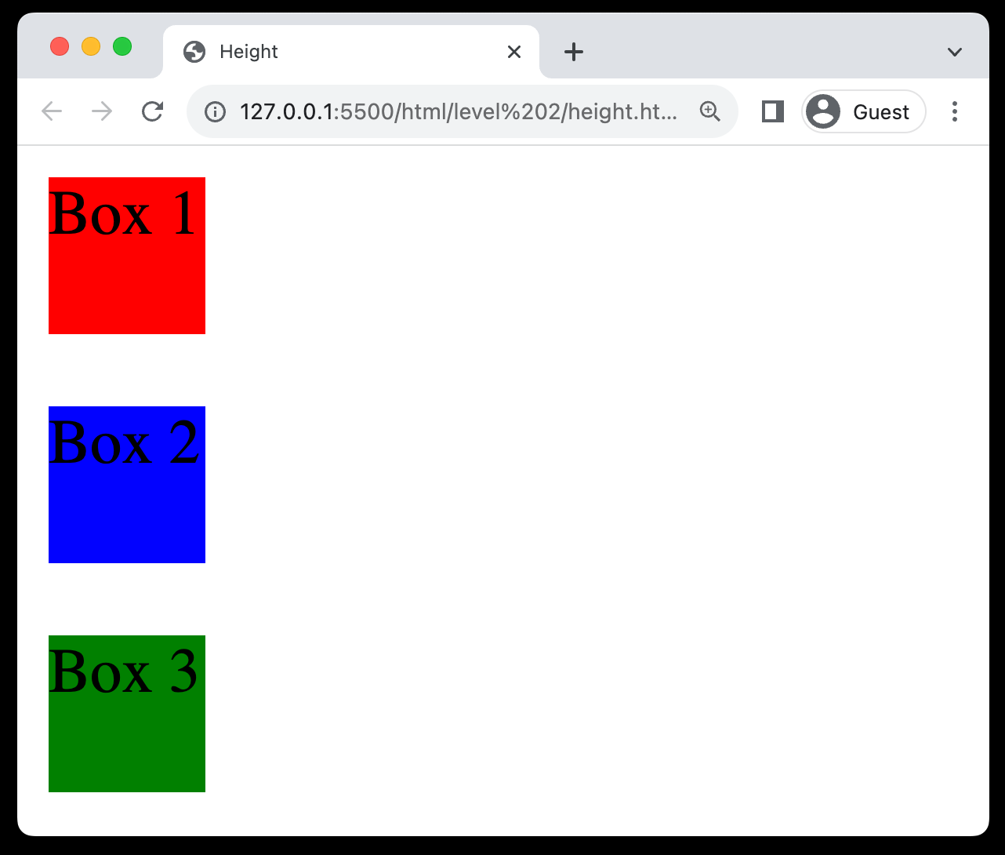
12. Height & Width Property
Dimensions Control: Used to specify the height and width of elements.
Unit Variability: Can use units like pixels (px)
Box Model Component: Influences padding, border, and margin.
Min and Max Values: Can utilize min-height, max-height, min-width, and max-width to set restrictions on dimensions.

Slide 33
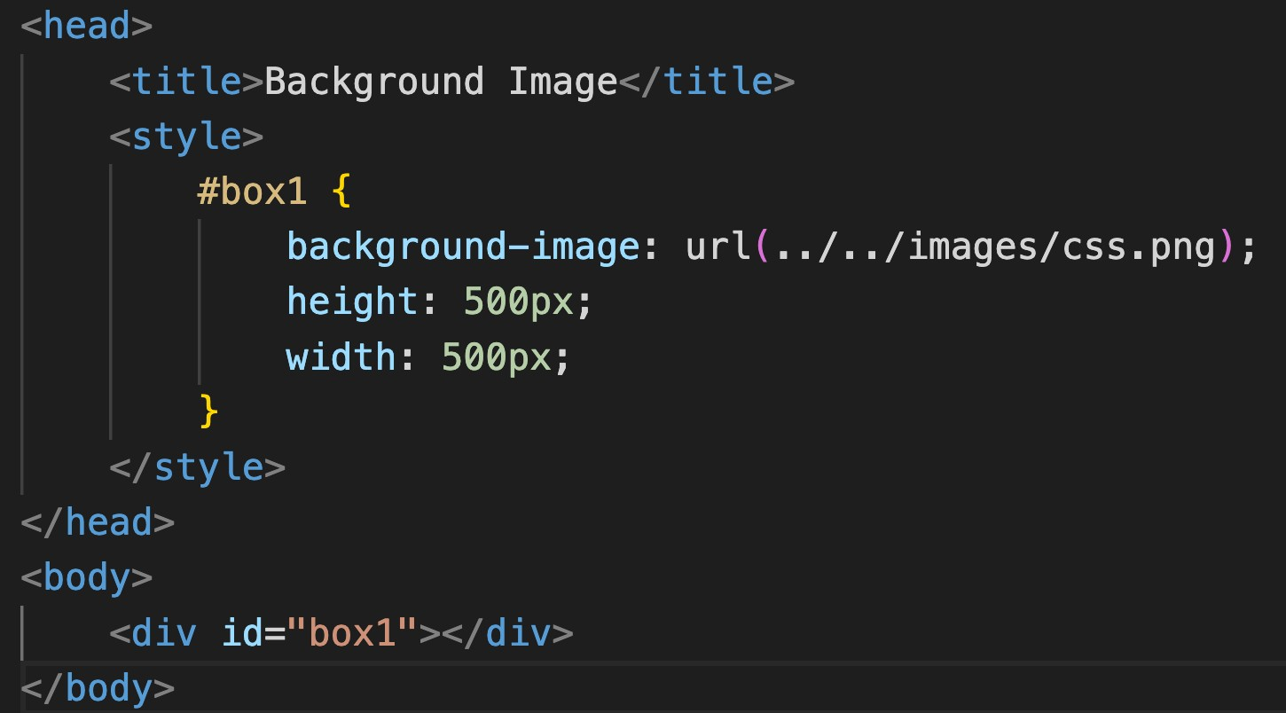
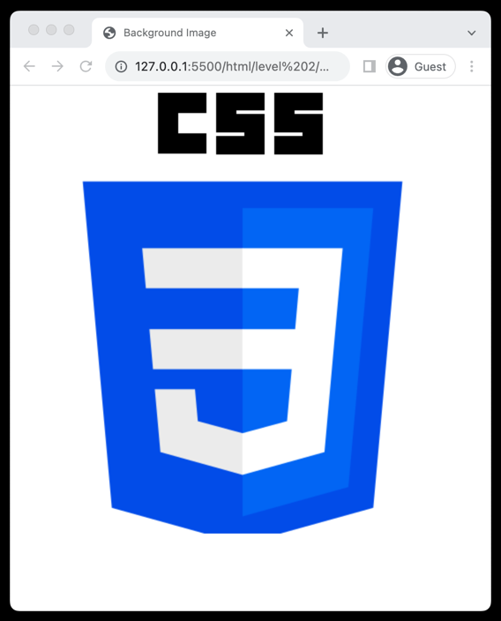
13. Background image Property
Usage: Adds an image as a background to elements.
Syntax: Defined using background-image: url('path/to/image’);.
Repetition: Control image repetition using
background-repeat.
Positioning: Adjust image position using background- position.
Size Control: Manipulate image size using background-size.
Background-Attachment: Sets whether the background image scrolls with the element or remains fixed.
Shorthand (color, image, repeat, attachment, position)

Slide 34
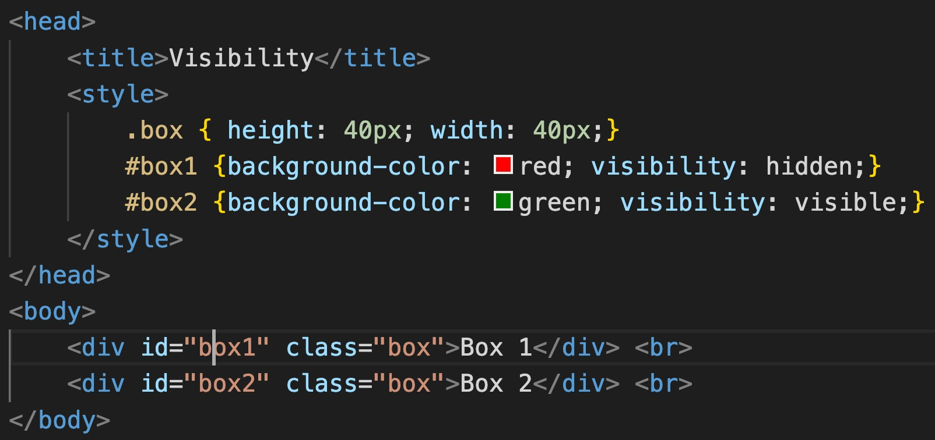
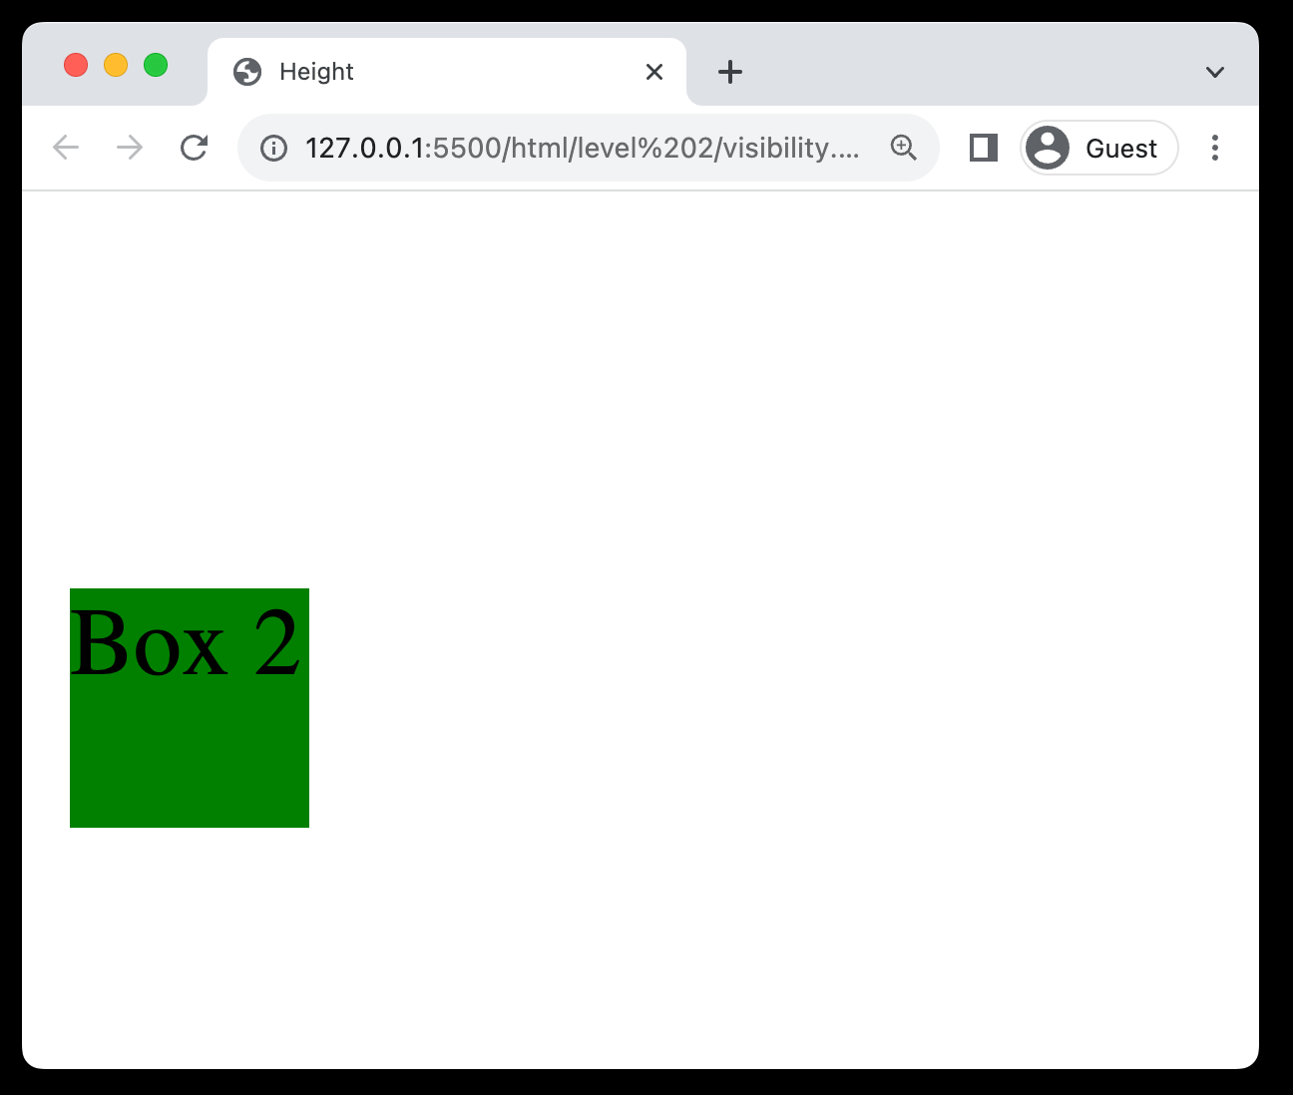
14. Visibility Property
Usage: Controls the visibility of elements without changing the layout.
Values: Can take visible, hidden, or collapse as values.
Space Occupancy: Even when hidden, the element occupies space.
Interactivity: Hidden elements are not accessible to user interactions.

Slide 35
Practice Set Level 2
Color System & Background
Create a div bar with text and background color with opacity
Change the color of the main
content
Add background image to one div
Use background shorthand property

Slide 36
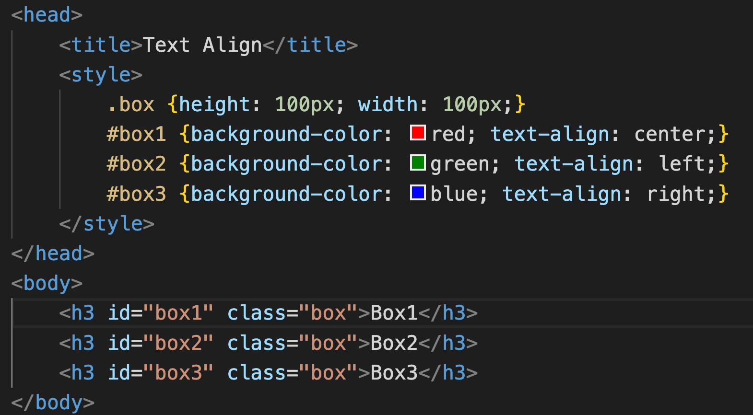

15.Text-Align Property
Usage: Controls the horizontal alignment of text within an element.
Values: Can take values like left, right, center, and justify.
Visual Appeal: Enhances readability and visual appeal by organizing text neatly.

Slide 37


16. Text-Decoration Property
Usage: Modifies the appearance of inline text.
Values: Options include none, underline, overline, and line-through.
Hyperlinks: Commonly used to remove underlines from hyperlinks for
aesthetic purposes.

Slide 38


16. Text-Decoration Property (style)

Slide 39


16. Text-Decoration Property (color)

Slide 40


17. Text-Transform Property
Usage: Controls the capitalization of text.
Common Values: Can be uppercase, lowercase, or capitalize.
None Value: none value disables text transformations.
Typography: Useful for setting text style and improving typography in web design.

Slide 41


18. Line Height
Usage: Adjusts the amount of space above and below inline elements.
Readability: Enhances text readability by preventing overcrowding.
Vertical Spacing: Useful for controlling vertical spacing between lines
of text.

Slide 42


19. Font Property (font-size)
Usage: Sets the size of the font in web content.
Responsiveness: Helps in creating responsive designs adaptable to various screen sizes.
Readability: Crucial for ensuring the readability of text on websites.

Slide 43


19. Font Property (font-weight)
Usage: Defines the thickness of characters in a font.
Values: Can take values like normal, bold, bolder, or numeric values (100 to 900).
Text Emphasis: Utilized to emphasize text or create contrast between text elements.

Slide 44


19. Font Property (font-style)
Usage: Controls the style of the font, mainly affecting its inclination.
Values: Common values are normal, italic, and oblique.
Text Formatting: Useful for highlighting or distinguishing certain text segments.

Slide 45

20. Font Family
Usage: Defines which font should be used for text within an element.
Specific Fonts: Common choices include Arial, Segoe UI, Times New Roman, and others.
Fallback Mechanism: Incorporate a fallback
font family in case the primary font is unavailable; helps in maintaining the site aesthetics.
Web Safe Fonts: Employ web-safe fonts to ensure consistency across different browsers and operating systems.
Generic Family: Always end the font family list
with a generic family like serif or sans-serif as a last resort option.

Slide 46


20. Font Family

Slide 47


21. Icons using Fonts
Using https://fontawesome.com

Slide 48
Practice Set Level 3
Text Properties
Create an Heading at the centre and make capitalized
Use Font family for the whole page to TimeNewRoman
Create one div inside another div. Set id and text outer to outer div,
set id and text inner to inner div. Set outer div text size to 25px.
Set inner to 10px.
Use icons from fontawesome.com and use icons of LinkedIn and GitHub

Slide 49
Level 4
Box Model
What is Box Model
Padding Property
Margin Property
Border Property

Slide 50

22. What is Box Model
fमठाई भ'डार पे चलो
Core Concept: Central concept in CSS that outlines the design and layout of elements on
the web page.
Components: Consists of four main components - margin, border, padding, and content.
Margin: The space outside the border,
separating the element from others.
Border: The outline that encapsulates the padding and content.
Padding: The space between the border and the actual content, providing a buffer.
Content: The innermost layer where text, images, or other media are housed.

Slide 51


23. Padding Property
Usage: Defines the space between the content of an element and its border.
Individual Sides: Allows setting padding for individual sides using
padding-top, padding-right, padding-bottom, and padding-left.
Shorthand: Can use shorthand property padding to set all sides at once, e.g., padding: 10px 20px 10px 20px.

Slide 52


24. Margin Property
Functionality: Sets the space around elements, separating them from others.
Individual Sides: Customizable for top, right, bottom, and left sides.
Shorthand: Allows quick setup, e.g., margin: 10px 20px. (clockwise)
Auto Value: Can be used for central alignment with auto value.

Slide 53



24. Border Property
Usage: Creates an outline around HTML elements.
Components: Defined by width, style, and color attributes.
Styles: Includes options like solid, dashed, and dotted.
Shorthand: Can set attributes at once, e.g., border: 2px solid black.

Slide 54


24. Border Property (border radius)
Usage: Used to create rounded corners for elements.
Individual Corners: Allows setting different radii for each corner.
Shorthand: e.g., border-radius: 10px 20px.

Slide 55




24. Border Property (box sizing)

Slide 56
Practice Set Level 4
Box Model
Create a div with height and width 200px and observe different values in the box model by inspecting.
Create a button and give 10px padding to top and bottom and 15px on the sides.
Add 100px margin to the button on all sides.
Add dotter border with color red and so much that the button becomes a circle.
Create two boxes with different box-sizing values and observe changes in box model.

Slide 57
Level 5
Display and Position
Display Property
Responsive Websites
Relative Units
Position Property
Semantic Tags

Slide 58


26. Display Property (Block / Inline Elements)
Block Elements
Inline Elements
New Line: Start on a new line.
Full Width: Take up all horizontal space.
Styling: Can have margins and padding.
Size: Width and height can be set.
Examples: <div>, <p>, <h1>, <ul>, <li>.
Flow: Stay in line with text.
Width: Just as wide as the content.
No Break: No new line between elements.
Limited Styling: Can't set size easily.
Examples: <span>, <a>, <strong>, <em>.

Slide 59



26. Display Property (Block)

Slide 60



26. Display Property (Inline)

Slide 61



26. Display Property (Inline-Block)

Slide 62



26. Display Property (None)

Slide 63

27. Responsive Website

Slide 64

27. Responsive Website
Adapts layout for different screen sizes
Flexible layouts
Optimizes images and assets
Enhances user experience on mobile and desktop

Slide 65

28. Relative Units

Slide 66



28. Relative Units (Percentage)
Relative Sizing: Facilitates dynamic sizing relative to parents.
Adaptability: Ensures responsiveness across various screens.
Dimensions: Quickly set width and height as a percentage.

Slide 67



28. Relative Units (EM)
Relative Unit: Sized relative to the parent element's font size.
Scalability: Facilitates easy scaling of elements for responsive design.
Font Sizing: Commonly used for setting font sizes adaptively.

Slide 68


28. Relative Units (REM)
Relative Sizing: Facilitates dynamic sizing relative to root element.
Adaptability: Ensures responsiveness across various screens.
Dimensions: Quickly set width and height as a percentage.

Slide 69


28. Relative Units (VW/VH)
Viewport Relative Units: Units based on viewport's width (vw) or height (vh) for responsive design.
Responsive Layouts: Essential for creating adaptive layouts; e.g., height: 100vh for full-screen sections.
Element Sizing: Useful for defining heights and widths that scale with the
viewport.

Slide 70

29. Position Property
Static (default) : Elements follow the normal document flow. (top, right, bottom, left, z-index would not work)
Relative: Element's position adjusted from its normal position.
Absolute: Positions element relative to the nearest positioned ancestor.
Fixed: Element positioned relative to the viewport, does not move on scroll.

Slide 71



29. Position Property

Slide 72



29. Position Property (z index)
Stacking Order: Determines the stacking order of elements along the Z-axis.
Position Context: Only applies to elements with position set to
relative, absolute, fixed, or sticky.
Integer Values: Accepts integer values, including negative numbers.
Higher Values: An element with a higher z-index value appears above others.

Slide 73



31. Float Property
Element Alignment: Allows elements to be aligned to the left or right within their containing element.
Values: Can take values like "left", "right", or "none" to determine the
floating direction.
Old Layout Technique: Less commonly used with the advent of Flexbox.

Slide 74

32. What is Flexbox?
Flexbox is a one-dimensional layout method for arranging items in rows or columns. Items flex (expand) to fill additional space or shrink to fit into smaller spaces.

Slide 75

33. Flex Model
display: flex

Slide 76

34. Flexbox Direction
Property Name: flex-direction is the property used to define the direction in a flex container.
Row Layout: row value aligns the flex items horizontally, in a left-to-right fashion.
Column Layout: column value stacks the flex items vertically, from top to bottom.
Reverse Direction: Adding -reverse to row or column (as in row-reverse or column-reverse) reverses the order of the items.

Slide 77



34. Flexbox Direction

Slide 78


34. Flexbox Direction

Slide 79

35. Properties: Flexbox container (Justify Content)
Alignment: Aligns flex items along the main axis.
flex-start: Items align to the start of the flex
container.
flex-end: Items align to the end of the flex container.
Center: Items are cantered within the flex container.
space-between/space-around/space-evenly: Distributes space between items evenly.

Slide 80


35. Properties: Flexbox container (Justify Content)

Slide 81

35. Properties: Flexbox container (Flex Wrap)

Slide 82


35. Properties: Flexbox container (Flex Wrap)

Slide 83


35. Properties: Flexbox container (Align Items)
This property is used to align the flex container's items along the cross-axis, which is perpendicular to the main axis.

Slide 84


35. Properties: Flexbox container (Align Content)
It is utilized to adjust the spacing between flex lines within a flex container, particularly when there is extra space along the cross- axis.

Slide 85


36. Properties: Flex Items (Order)
The "order" property in CSS allows you to define the sequence in which flex items appear within the flex container, overriding their original order in the HTML.

